Slide 1
AutoMatica
Build Smarter, Not Harder.
Team Mu

Slide 2

AutoMatica
Automates publishing of Customization packages
Schedule you're publishing and work smarter
Notify your developers/ISV/Partners/Customer
Share logs/trace for troubleshooting with developers
Fully integrated for future automations

Slide 3
Key Takeaway

Slide 4
I am in control of my time

Slide 5
Let’s Demo AutoMatica
Let’s Demo

Slide 6
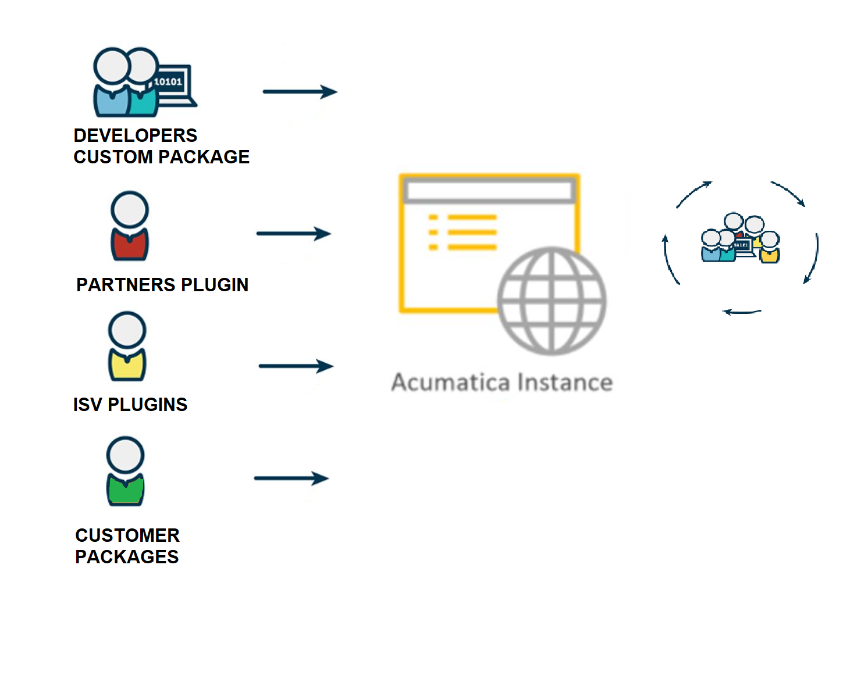
Problem
Compatibility issues with custom packages
No control over when custom packages are published
Difficulty communicating with partners/ISVs to fix errors

Slide 7
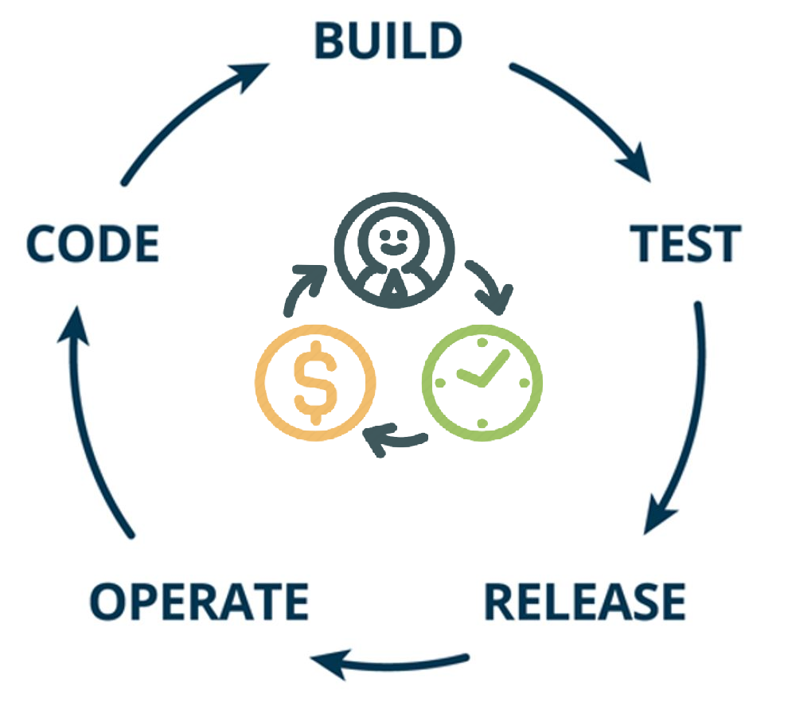
Benefits
Schedule customization manager
Impactful communication to package stakeholders
Efficient time management of resources
Reduce roadblock risk in rapid development CI / CD pipeline
Increased quality through effective collaboration

Slide 8
Future Enhancements
Push notifications – To alert users of the publication of the packages
Extend End-point – Remote importing packages
Snapshot automation
Advanced Scheduling
Ver 2.0

Slide 9







Brandon Sproul
Patrick Chen
Shawn Goodwin
Chetan Srinivas
Developer -
Developer – SPS Commerce
Martin Asscoiates
Product Manager - Kensium
Vidya
Paul Gilfoy
Harsha Sarjapur
Acumatica SME
Engineer – PriceKubecka
InfoSourcing Inc

Slide 10



